Slide 1
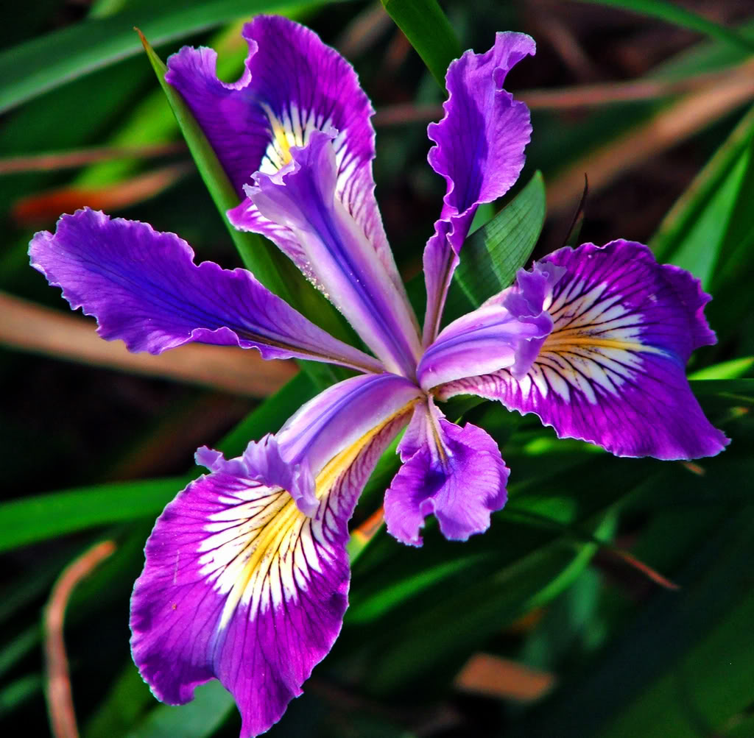
IRIS FLOWER CLASSIFICATION AND COMPARATIVE ANALYSIS OF DIFFERENT CLASSIFIERS USING MACHINE LEARNING

Slide 2
Rijushree Guha University Roll No 12019009002167 Poulomi Biswas University Roll No 12019009023042 Aditi Mukherjee University Roll No 12019009001414 Rajdeep Mondal University Roll No 12019009001236 Soumya Dey University Roll No 12019009001403 Someswar Roy University Roll No 12019009001040
GROUP MEMBERS

Slide 3
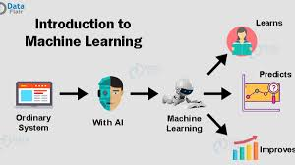
Machine Learning and its Types
Machine learning is an application of artificial intelligence (AI) that provides systems the ability to automatically learn and improve from experience without being explicitly programmed.
The process of learning begins with observations or data, such as examples, direct experience, or instruction, in order to look for patterns in data and make better decisions in the future based on the examples that we provide. The primary aim is to allow the computers learn automatically without human intervention or assistance and adjust actions accordingly.

Slide 4
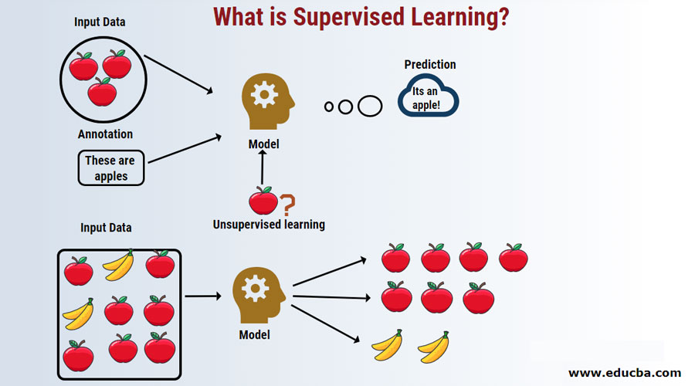
Supervised Learning

Slide 5
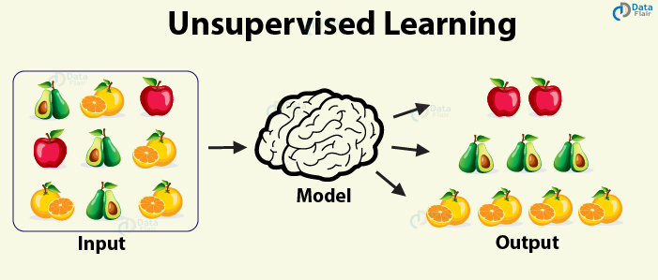
Unsupervised Learning

Slide 6
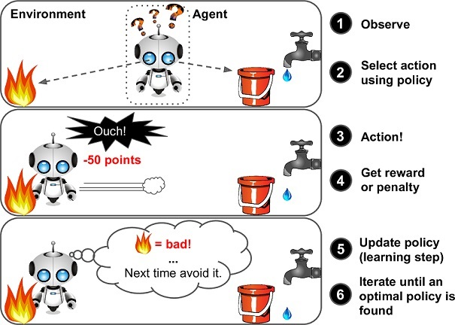
Reinforcement Learning

Slide 7
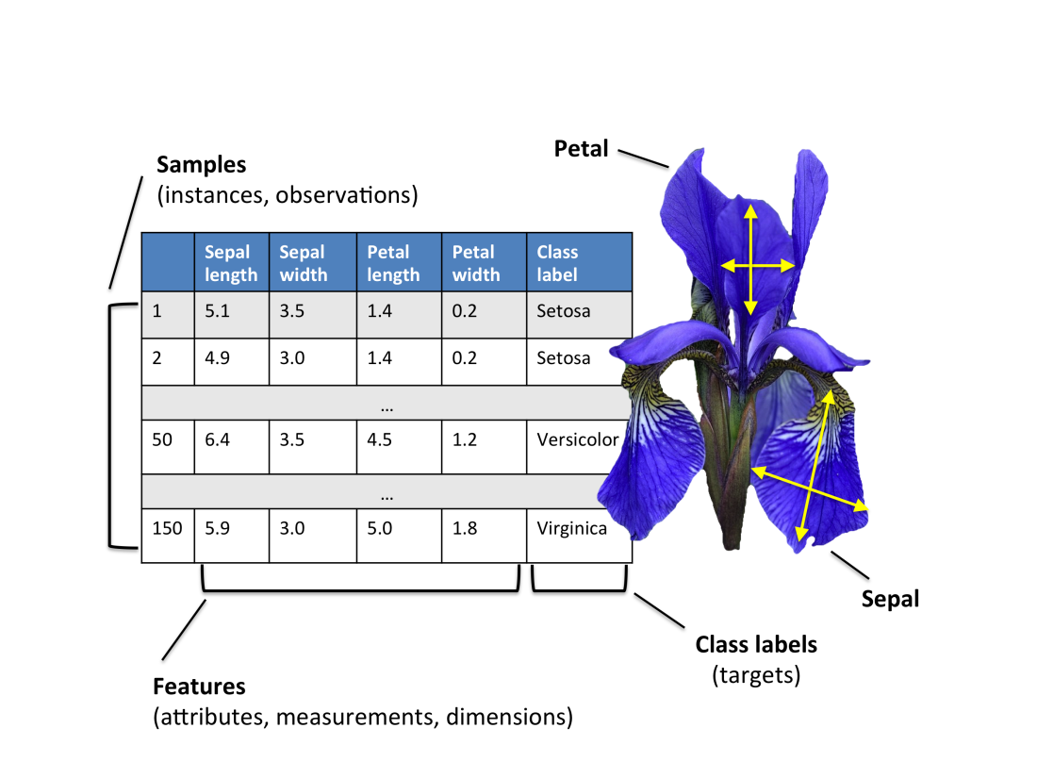
About Iris Flower
The Iris flower data set or Fisher's Iris data set is a multivariate data set introduced by the British statistician, eugenicist, and biologist Ronald Fisher in his 1936 paper
The Iris flower data set or Fisher's Iris data set is a multivariate data set introduced by the British statistician, eugenicist, and biologist Ronald Fisher in his 1936 paper
The dataset contains a set of 150 records under five attributes - sepal length, sepal width, petal length, petal width and species.

Slide 8
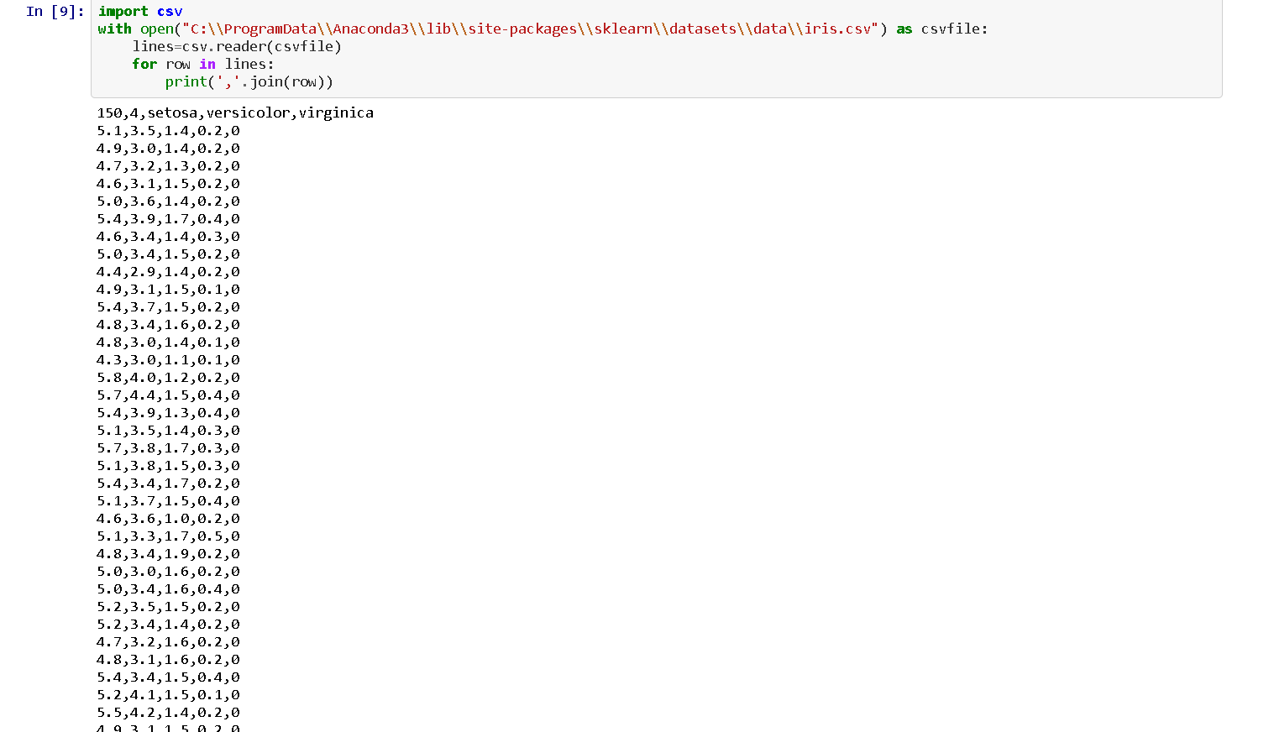

Slide 9
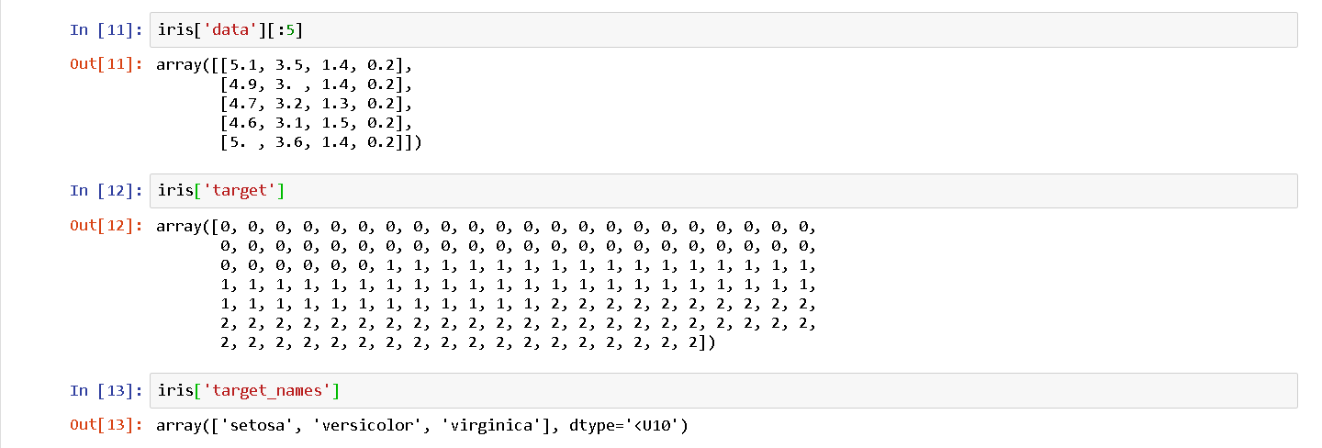
The data set consists of 50 samples from each of three species of Iris (Iris setosa, Iris virginica and Iris versicolor). Four features were measured from each sample: the length and the width of the sepals and petals, in centimeters. Based on the combination of these four features, Fisher developed a model to distinguish the species from each other.

Slide 10
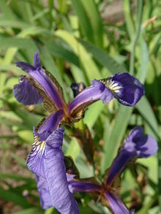
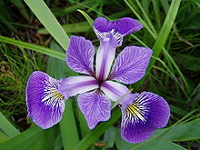
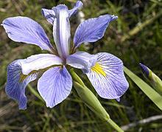
Species
Iris Setosa
Iris Versicolor
Iris Verginica

Slide 11
Why making a model on this dataset?
The Iris dataset is a classic dataset from the 1930s; it is one of the first modern examples of statistical classification.
The dataset is a collection of morphological measurements of several Iris flowers. These measurements will enable us to distinguish multiple species of the flowers. Today, species are identified by their DNA fingerprints, but in the 1930s, DNA’s role in genetics had not yet been discovered.
The application will introduce many rudimentary features and concepts of machine learning and is a good use case for these types of models.
We prefer to start from the beginning before going deep
Use case: Botanist want to determine the species of iris flower .

Slide 12
Problem Statement
To create a model that can classify the different species of the Iris flower(setosa,versicolour,verginica) when given unkown parameters(sepal length, sepal width, petal length, petal width) and analysis which classifier is the best

Slide 13
PROPOSED SOLUTION
We will use only supervised learning techniques to predict the labels of the unkown species.
Problem solving apporach:
create the dataset.
Build the model
Train the model
Make predictions.

Slide 14
ALGORITHMS USED
K Nearest Neighbor
Decision Tree
Random Forest
Naïve Bayes
LDA
Logistic Regression
SVM

Slide 15
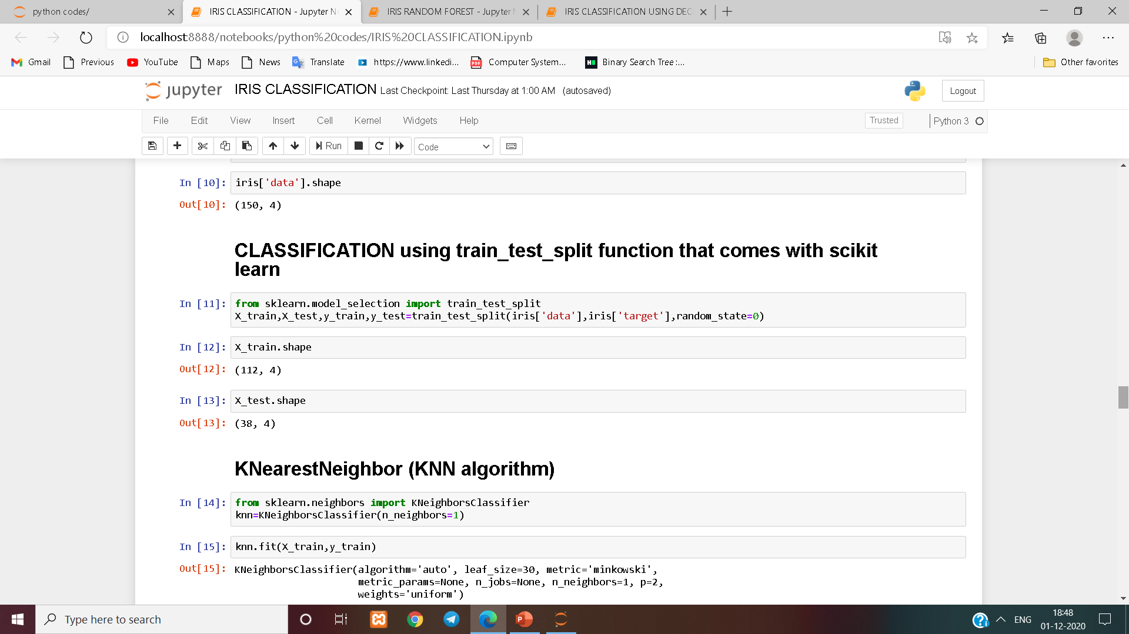
Now before we can apply our model to new measurements ,we need to divide it into training and testing set.
This is usually done by splitting the labelled dataset into two parts-
Training set- The part of the data used to build our machine learning model.
Testing set- The rest of the data will be used to access how the works.

Slide 16
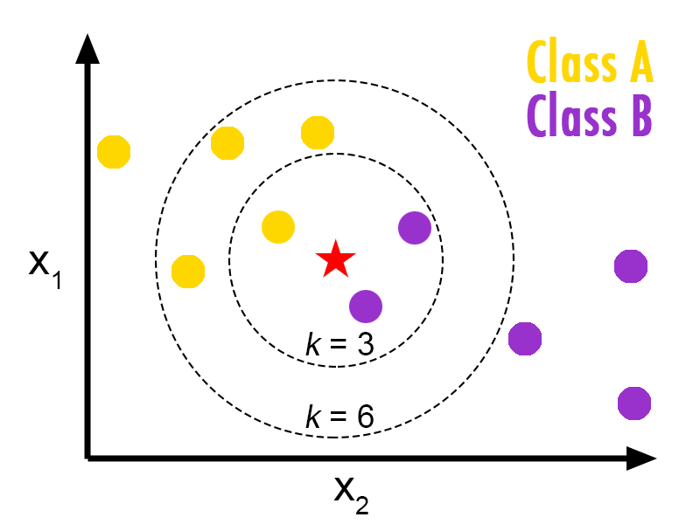
K Nearest Neighbor
• KNN algorithm is based on feature similarity (i.e how closely the out-of-sample features resemble our training set)
K-nearest neighbors of a record x are data points that have the k smallest distances to x (here x is the red star)
– Use class labels of nearest neighbors to determine the class label of unknown record (e.g., by taking majority vote)

Slide 17
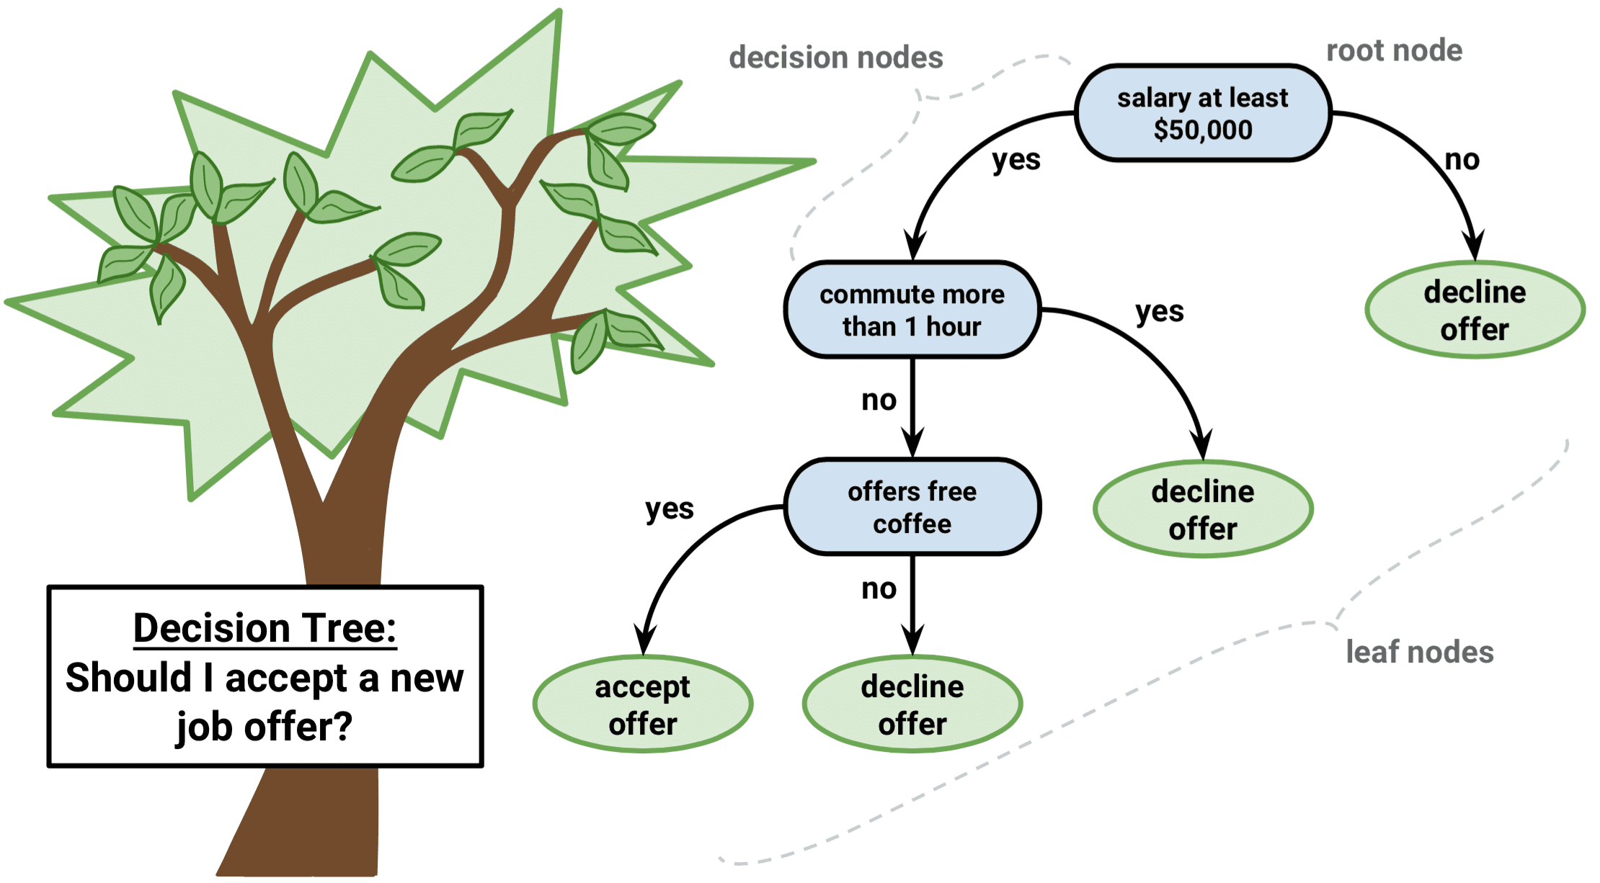
DECISION TREE CLASSIFIER
It is a tree-structured classifier, where internal nodes represent the features of a dataset, branches represent the decision rules and each leaf node represents the outcome.
Decision Tree Classifier, repetitively divides the working area(plot) into sub part by identifying lines. (repetitively because there may be two distant regions of same class divided by other).
Capable of performing multi-class classification on dataset.

Slide 18
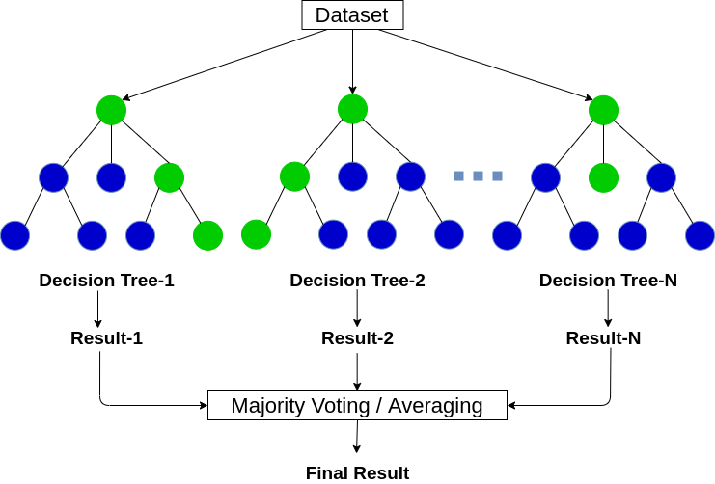
RANDOM FOREST
It creates a forest with a number of decision trees.
The more the number of trees, the more robust the prediction and thus higher accuracy.
Handle large dataset with higher dimensionality.
Choose the classification having the most votes(majority) for all the trees of the forest.
[Out of context: Average vote in case of regression]

Slide 19
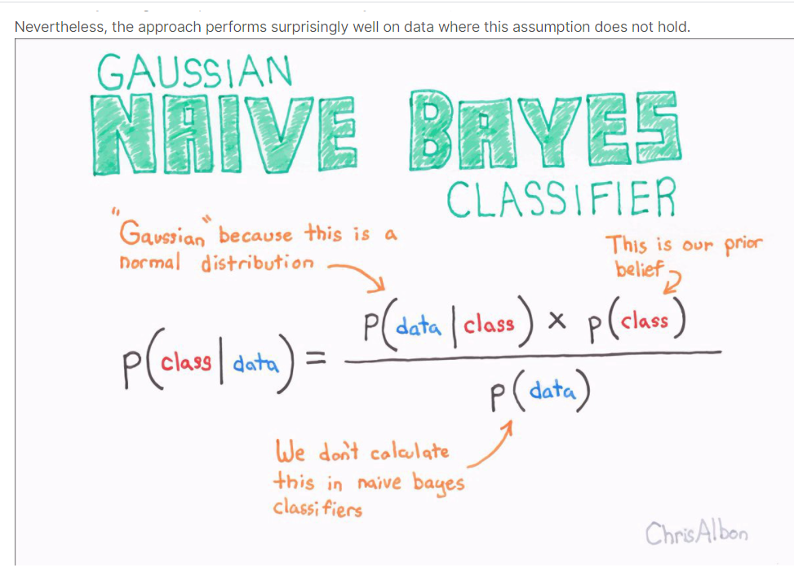
Naïve Bayes
Naive Bayes is a classification algorithm for binary (two-class) and multi-class classification problems. The technique is easiest to understand when described using binary or categorical input values.
It is called naive Bayes or idiot Bayes because the calculation of the probabilities for each hypothesis are simplified to make their calculation tractable. This is a very strong assumption that is most unlikely in real data, i.e. that the attributes do not interact.
The approach performs surprisingly well on data where this assumption does not hold.

Slide 20
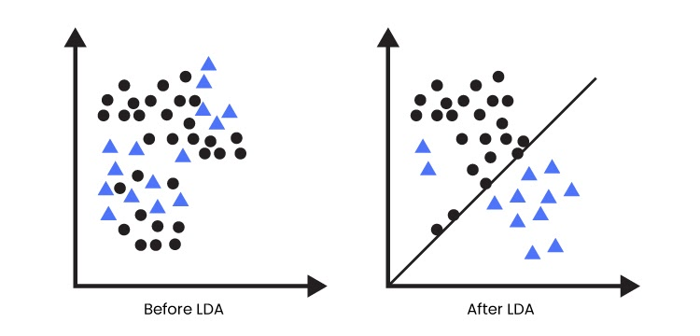
Linear Dicriminant Analysis
Linear Discriminant Analysis (LDA) is a dimensionality reduction technique. As the name implies dimensionality reduction techniques reduce the number of dimensions (i.e. variables) in a dataset while retaining as much information as possible.

Slide 21
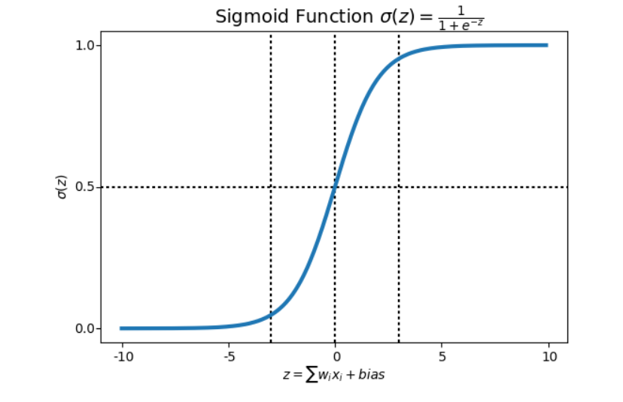
Logistic Regression
Logistic Regression is a Machine Learning algorithm which is used for the classification problems, it is a predictive analysis algorithm and based on the concept of probability.
We can call a Logistic Regression a Linear Regression model but the Logistic Regression uses a more complex cost function, this cost function can be defined as the ‘Sigmoid function’ or also known as the ‘logistic function’ instead of a linear function.

Slide 22
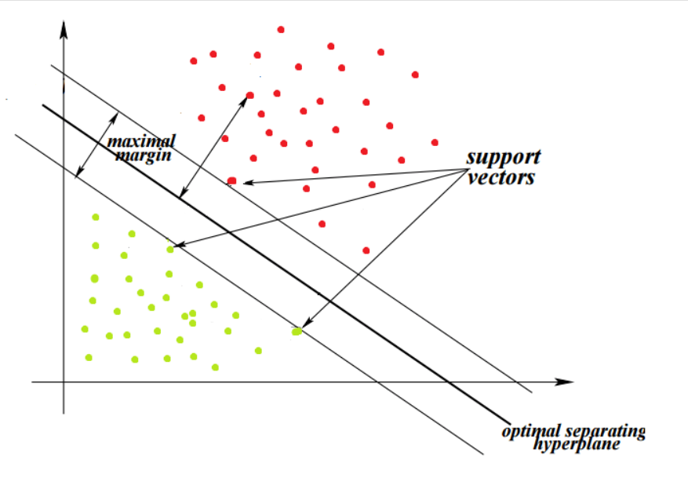
Support Vector Machine
Support Vector Machine” (SVM) is a supervised machine learning algorithm which can be used for both classification or regression challenges. However, it is mostly used in classification problems. In the SVM algorithm, we plot each data item as a point in n-dimensional space (where n is number of features you have) with the value of each feature being the value of a particular coordinate. Then, we perform classification by finding the hyper-plane that differentiates the two classes very well

Slide 23
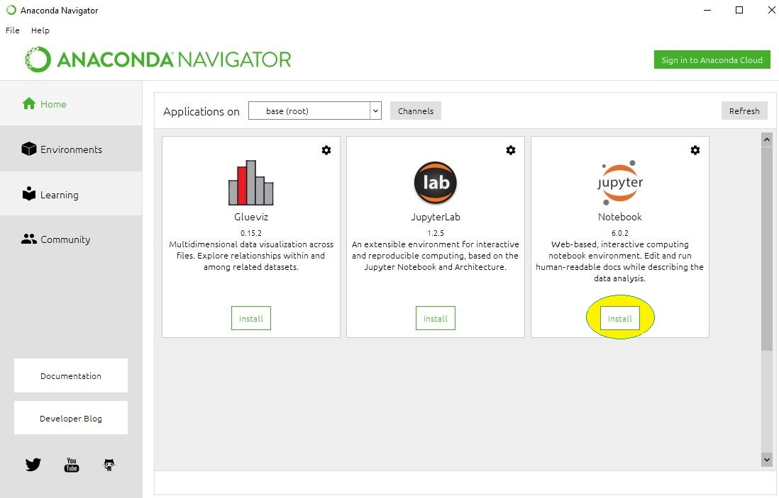
EXPERIMENTAL SETUP AND RESULT ANALYSIS
Things we need to download and install:
Anaconda
https://www.anaconda.com
Then after from it install-
Jupyter notebook

Slide 24
Importing the libraries
First of all, let’s import the modules,packages …. as listed below:
SkLearn is a pack of Python modules built for data science applications (which includes machine learning). Here, we’ll be using three particular modules:
load_iris: The classic dataset for the iris classification problem. (NumPy array)
train_test_split: method for splitting our dataset.
KNeighborsClassifier: method for classifying using the K-Nearest Neighbor approach.
NumPy is a Python library that makes it easier to work with N-dimensional arrays and has a large collection of mathematical functions at its disposal. It’s’ base data type is the “numpy.ndarray”.
pandas Pandas is a high-level data manipulation tool developed by Wes McKinney. It is built on the Numpy package and its key data structure is called the DataFrame. DataFrames allow you to store and manipulate tabular data in rows of observations and columns of variables.
matplotlib Matplotlib is a plotting library for the Python programming language and its numerical mathematics extension NumPy.
DecisionTreeClassifier Decision Trees (DTs) are a non-parametric supervised learning method used for classification and regression.
RandomForestClassifier has multiple decision trees as base learning models.

Slide 25
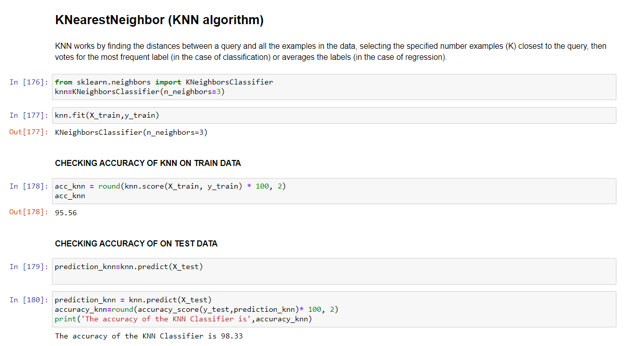
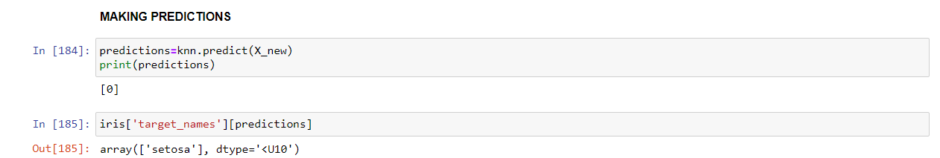
RESULT ANALYSIS 1

Slide 26
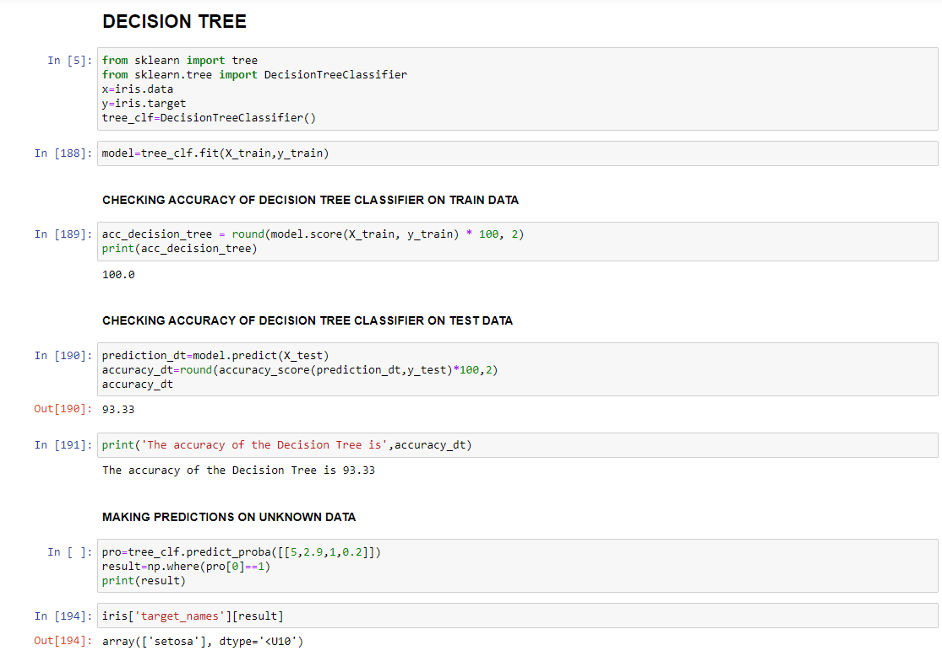
RESULT ANALYSIS 2

Slide 27
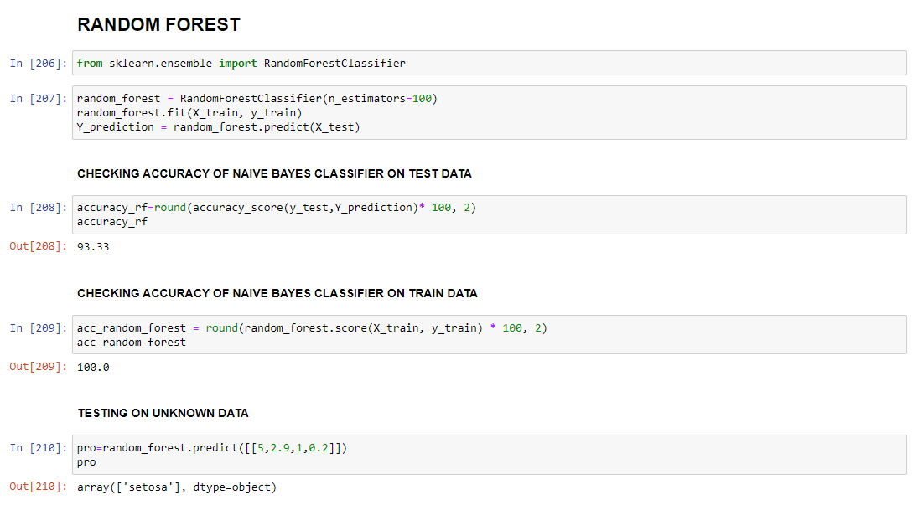
RESULT ANALYSIS 3

Slide 28
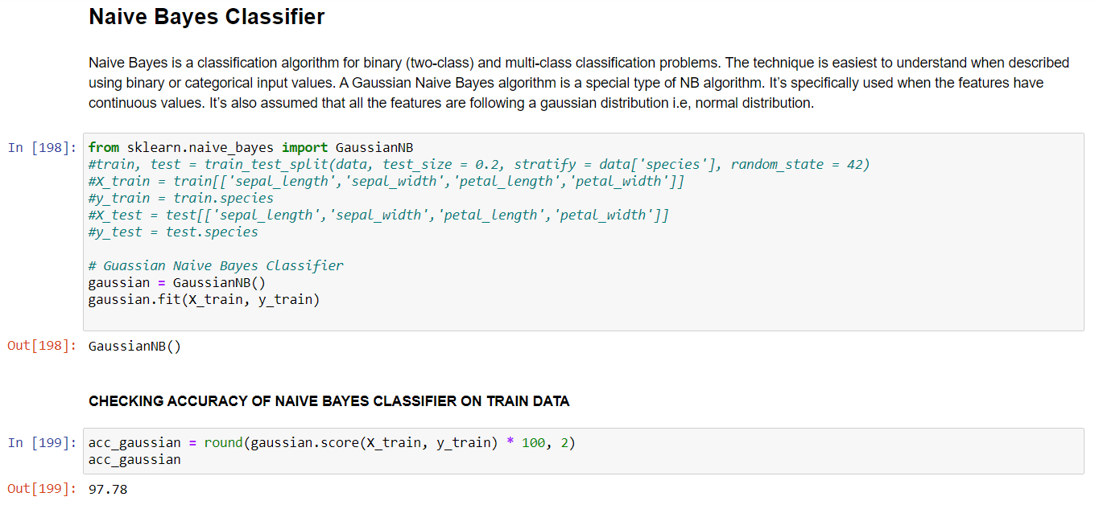
RESULT ANALYSIS 4

Slide 29
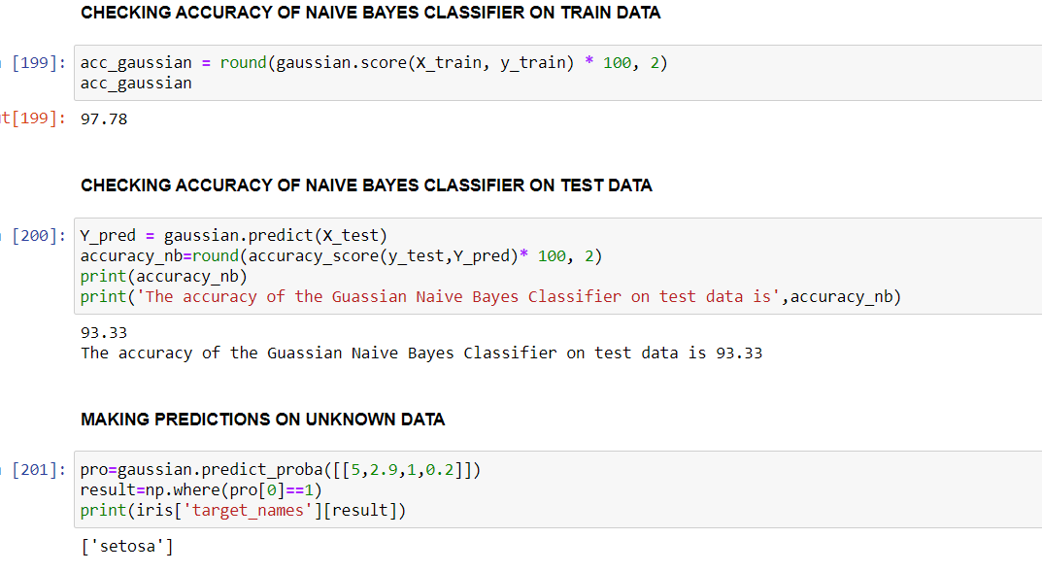

Slide 30
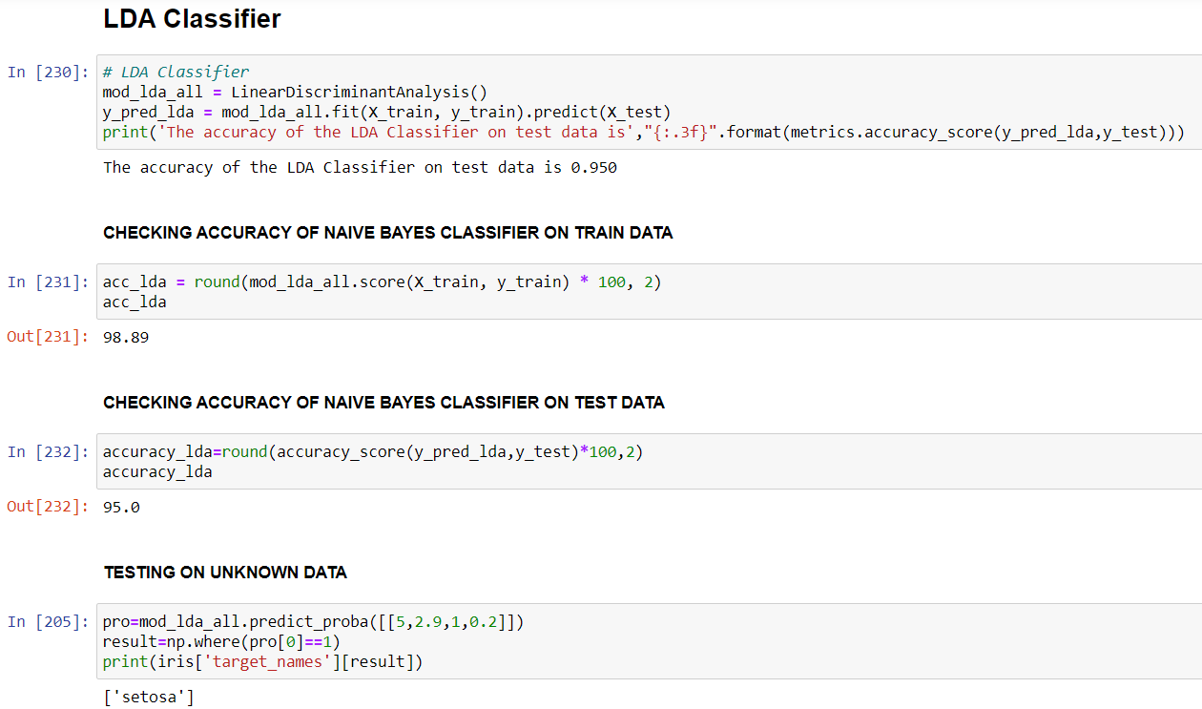
RESULT ANALYSIS 5

Slide 31
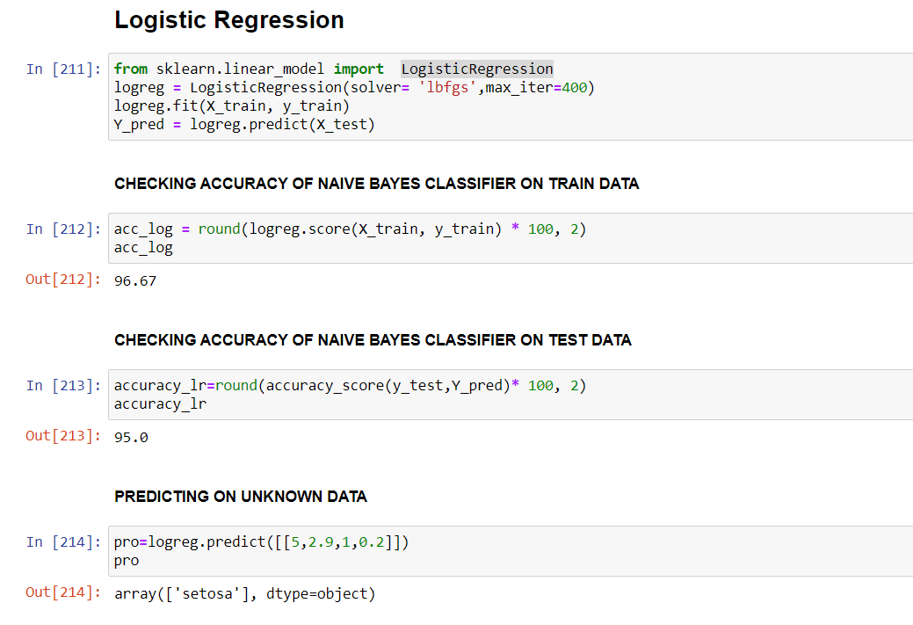
RESULT ANALYSIS 6

Slide 32
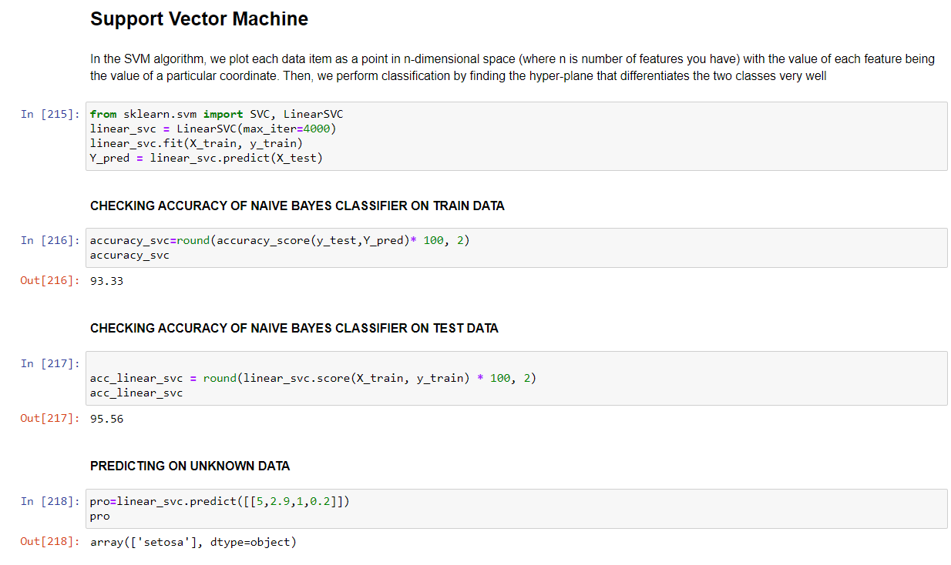
RESULT ANALYSIS 7

Slide 33
COMPARATIVE ANALYSIS OF DIFFERENT CLASSIFIERS USED
TO ANALYSE WHICH CLASSIFIER WORKS THE BEST FOR THIS MODEL
Which is the best Model ?

Slide 34
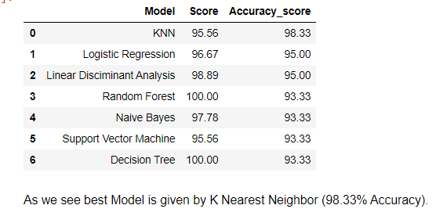
As we see best Model is given by KNN CLASSIFIER(98.33% Accuracy).

Slide 35
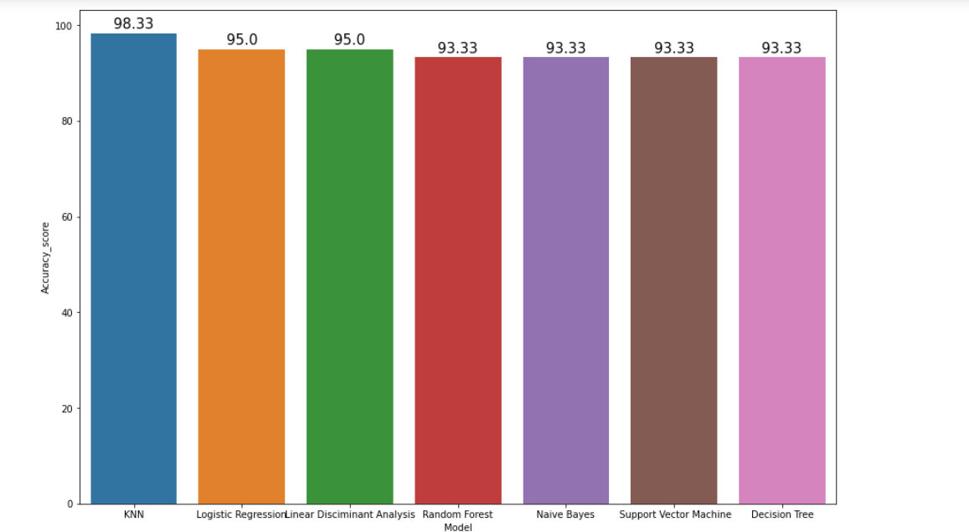
This was expected as we saw in the heatmap above that the correlation between the Sepal Width and Length was very low whereas the correlation between Petal Width and Length was very high. Thus we have just implemented some of the common Machine Learning. Since the dataset is small with very few features.
Thus the KNN algorithm works the best for this model.

Slide 36
CONCLUSION & FUTURE SCOPE
In this way w can do comparative analysis of different classifiers on others datasets also.
As we know now Machine Learning is a hot topic nowadays and has a lot of scope in near future , doing this project as a beginner made me learn many tools of ml and classification. I came to know a lot about supervised learning and its applications.
It is observed that among the seven classifiers KNN has the highest accuracy score although it varies among different data inputs given . This kind of classification is essential in many real life monitering systems like marking emails as spams or not and more . This classification works only when it is fed with some data and output as a training set(supervised learning). If atleast some labels are not given then its out of this scope and falls in unsupervised or reinforcement learning

Slide 37
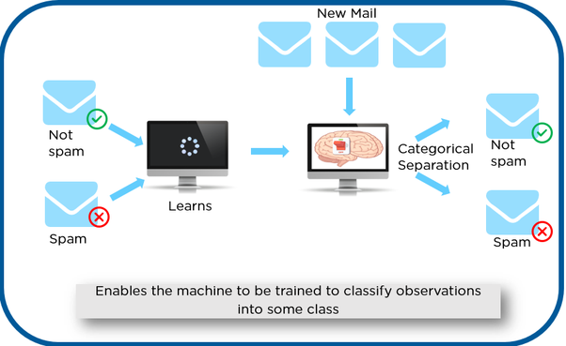
Why is it Important? Learning gives the algorithm experience which can be used to output the predictions for new unseen data Experience also helps in optimizing the performance of the algorithm Real-world computations can also be taken care of by the Supervised Learning algorithms
Machine learning is changing the world by transforming all segments including healthcare services, education, transport, food, entertainment, and different assembly line and many more. It will impact lives in almost every aspect, including housing, cars, shopping, food ordering, etc. Technologies like Internet of Things (IoT) and cloud computing are all growing implementation of ML to enhance objects and gadgets into “smart” for themselves.

Slide 38
THANK YOU

